Slide 1
Cost Management
Admin Pitch Deck – L200

Slide 2
Agenda
1
Overview
2
Scenarios
3
Feature walkthrough
Activate – set default policy
Configure – add spending policies
Reporting – overview and consumption

Slide 3
Partner instructions to enable customers for Cowork usage
Who this applies to:
CSP/MSP partners
Other partners with a management relationship on behalf of their customers
Step 1: Ensure an Azure subscription is setup for your customer and linked to your Partner billing account
If customer has an existing Azure subscription, ensure it associated with your Partner billing account
If customer does not have an Azure subscription or it is not associated with your Partner billing account, create a new Azure subscription using the Azure Portal or Partner Center
Step 2: Configure usage-based billing in Microsoft 365 Admin Center (MAC)
Connect the Azure subscription associated with your billing account
Configure user access controls, spending limits, and alerts
Ensure setting is turned on that allows users to discover & use usage-based services
Note: AOBO¹ (w/ GDAP² permissions) required to complete setup on behalf of customer
Learning resources:
Azure Plan for CSP — Overview & Hub The central landing page for CSP partners to understand, purchase, and manage Azure at pay-as-you-go rates for customers under the Microsoft Customer Agreement
Purchase the Azure Plan for Customers (Partner Center) Step-by-step guide for CSP partners (User Management Admin / Sales Agent role) to add an Azure Plan to a customer's account in Partner Center after confirming Microsoft Customer Agreement acceptance
Manage Subscriptions & Resources Under the Azure Plan Explains the RBAC options available to CSP partners — including Admin on Behalf of (AOBO) and Azure Lighthouse — to maintain operational control of a customer's Azure environment
GDAP Overview Introduction to granular delegated admin privileges (GDAP)
Partner Cost Management Guidance Overview of setup and cost management instructions
1. AOBO = Admin on Behalf of; 2. GDAP = Granular Delegated Admin Permissions

Slide 4
Flat licensing falls short for power users and complex agents
Usage based billing helps costs become predictable and smooths out usage spikes
Today (Licensing)
With Cost Management
Most users
Most users
Predictable baseline (M365 Copilot license)
Predictable baseline (M365 Copilot license)
Unchanged — license remains the floor
Unchanged - license remains the floor
Power users + agents
Power users + agents
Capped or unpredictable cost
Capped or unpredictable cost
Variable use billed through Copilot Credits
Variable use billed through Copilot Credits
Billing currency
Billing currency
Per-seat SKU
Per-seat SKU
Copilot Credits (single, pooled currency)
Copilot Credits (single, pooled currency)
Purchase modes
Reporting
Annual seats
License utilization
P3 prepaid + PAYG fallback
Spend, intensity, monthly cycles

Slide 5
Moving to credit-based billing for Copilot agents and services
Giving admins controls to govern Copilot and AI consumption spend
1
Metered
2
Pooled
3
Governed
Services, users, and agents are billed by what is consumed. New capabilities like Work IQ APIs are consumption only.
Tenant-level capacity in Copilot Credits, with policy controls to manage.
Tools for admins including visibility, forecasting, and limits, built into MAC where admins already are.
Why now
Customers want to scale spend only as value appears · The market has standardized on consumption

Slide 6
Copilot Credits: pay for usage-based scenarios
Offers are MACC and CSP eligible
Pay-as-you-go
Prepaid Copilot Credits
Offer name
Copilot Credits Pay-as-you-go
Copilot Credits Pre-Purchase Plan
Ideal for
Flexibility to scale up or down
Predictable usage
Cost
$0.01
Lowest per-credit cost
Usage term
N/A
Annual

Slide 7
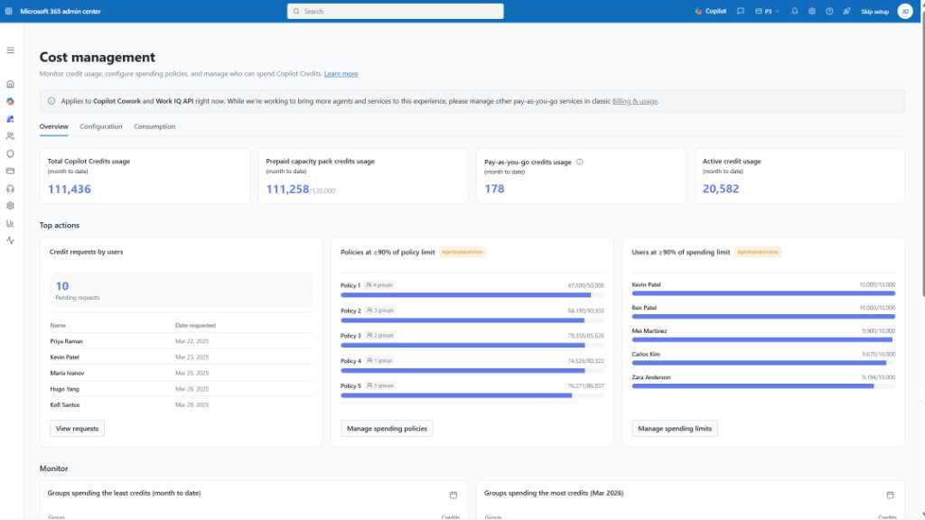
Manage spend from a centralized dashboard
Manage spend and unlock usage- based billing services
Monitor: Track Copilot Credit usage and runway, with reporting and spend trends
Configure: Select services, set limits and create spending policies at tenant, group, and user level
Purchase: Buy Copilot Credits and approved-user credit requests
Product images subject to change
Notes:
Once usage-based pricing is in place, the priority quickly becomes: how do I manage and stay on top of spend? The cost management dashboard in the Microsoft 365 admin center helps you do that. It gives admins a single place to monitor, control, and manage Copilot Credit usage across the organization.
There are three key things happening here.
First, monitoring. Admins can track usage, understand how quickly credits are being consumed, and see trends over time. This provides a clear view into adoption and helps identify where usage is accelerating.
Second, configuration. You can set limits and policies — at the tenant, group, or user level — to control how much can be spent and prevent overages before they happen.
And third, purchasing and allocation. This is where admins can buy additional Copilot Credits and manage how they’re distributed, including approving requests from users or teams.
So the key takeaway is that usage-based AI doesn’t come at the expense of control. Everything is centralized in one place, with the tools IT needs to monitor usage, enforce guardrails, and scale adoption responsibly.

Slide 8
Scenarios

Slide 9
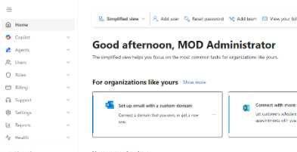
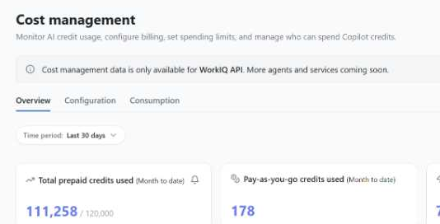
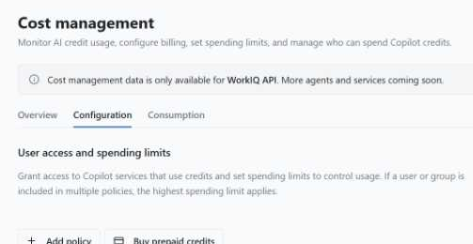
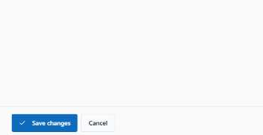
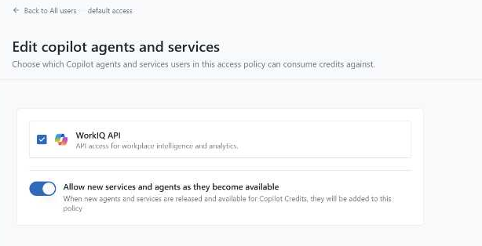
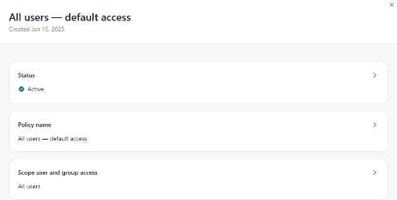

Scenario 1 - Guide
Agents leveraging premium services for common tasks
This example assumes an existing policy. If no policy is in place, admins can create one and apply it to the selected users or groups using a similar approach.
If a default policy is already in place and you'd prefer not to modify it, you can create a new policy with the specific changes instead.
Open the Microsoft Admin Center (MAC)
Select Cost Management
Select Configuration
Go to https://admin.microsoft.com/ to access MAC
Open the Copilot section and select Cost Management
Select the configuration tab next to the overview section currently displayed
Select save changes
Remove the services in question
Select your current policy
Once you have removed the service, you can then select Save changes to apply the policy.
Select Agents and Services to display what is currently being used. Select the service you want to remove.
Select the policy name for the policy you want to change to open the policy review window
Product images subject to change

Slide 10
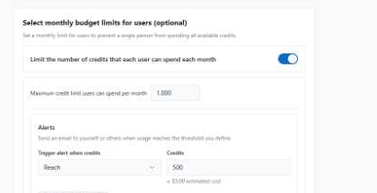
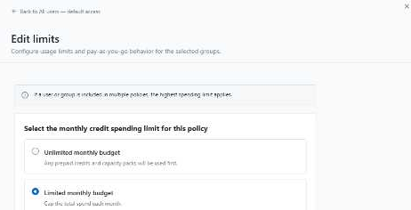
Scenario 2 - Guide
Users using credits unchecked
This example assumes an existing policy. If no policy is in place, admins can create one and apply it to the selected users or groups using a similar approach.
If a default policy is already in place and you'd prefer not to modify it, you can create a new policy with the specific changes via monthly, group and specific user limits instead.
Open the Microsoft Admin Center (MAC)
Select Cost Management
Select Configuration
Go to https://admin.microsoft.com/ to access MAC
Open the Copilot section and select Cost Management
Select the configuration tab next to the overview section currently displayed
Select save changes
Set a user limit within the group
Select limits and alerts
Once you have decided on individual user limits to prevent one individual using a team's monthly credit, select save changes to implement this.
Scroll down to the monthly budget limits for users' section, enable this and set a maximum credit limit users can spend each month.
Select the policy name for the policy you want to change to open the policy review window then select limits and alerts.
Product images subject to change

Slide 11
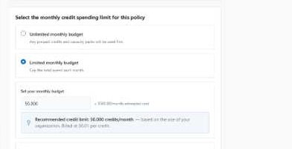
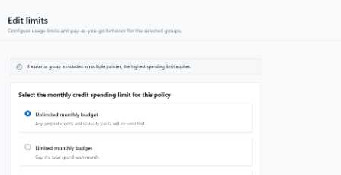
Scenario 3 - Guide
Departments overspending against allocation
This example assumes an existing policy. If no policy is in place, admins can create one and apply it to the selected users or groups using a similar approach.
If a default policy is already in place and you'd prefer not to modify it, you can create a new policy with the specific department changes via monthly and group limits instead.
Open the Microsoft Admin Center (MAC)
Select Cost Management
Select Configuration
Go to https://admin.microsoft.com/ to access MAC
Open the Copilot section and select Cost Management
Select the configuration tab next to the overview section currently displayed
Select save changes
Set a limited monthly budget
Select limits and alerts
Once you have decided on a limit for the department(s), select save changes to implement this.
Select Limited monthly budget and enter a spend limit to prevent the department(s) exceeding their allocation. If Admin wants to limit single user spending, create a group with one user.
Select the department’s policy name to open the policy review window then select limits and alerts.
Product images subject to change

Slide 12
Feature Walkthrough

Slide 13

Core Cost Management workflow for admins
The key steps to unlocking AI experiences and managing spend with usage-based billing
Activate default
policy
Configure spending policies
Purchase Copilot
Credits
Monitor usage
and optimize
Action
Turn on usage-based AI services with a default policy for your organization
Create spending controls at the tenant, group, and user level
Buy credits through pay-as-you-go or Prepurchase Plans (P3) at a discount
Analyze usage trends across groups, users, polices, and services
Global admin
Billing admin
AI admin
License admin
Notes:
There are 4 key steps to cost management.
Activate you default policy to turn on usage-based services and billing for your org.
Configure spending policies to control spend and usage at the group and user level.
Use existing subscriptions for billing and utilize options for paygo credits or Prepurchased Plans which provide annual credits at a discount.
Analyze usage trends and optimize spend through our reporting across groups, users, polices and services
Global and billing admins can work across all 4 steps. We also know that AI and license admins may be needed to configure specific spending policies so they have access to that as well.

Slide 14
Activate Default Policy

Slide 15
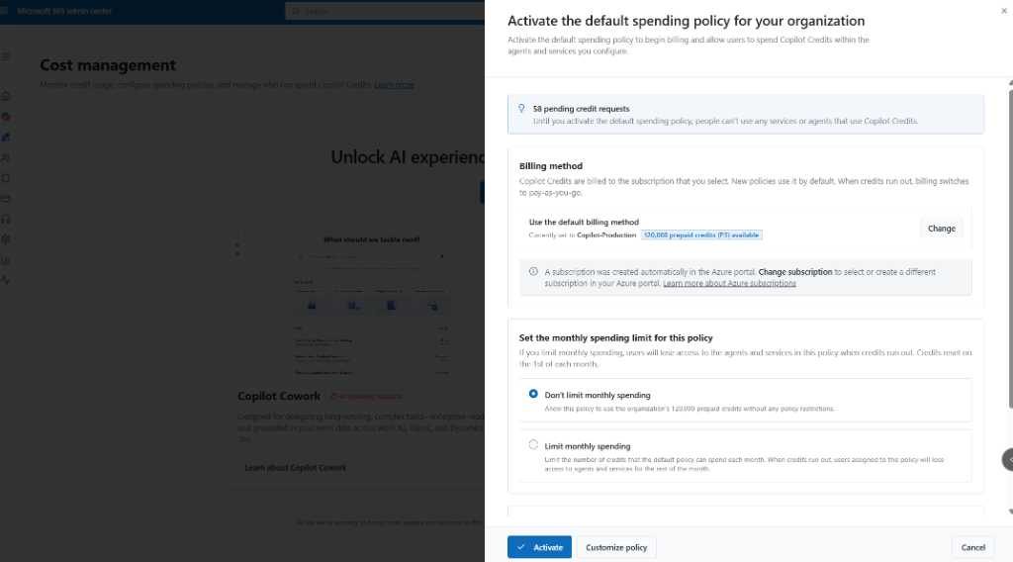
Activate default spending policy
Enable usage-based billing for AI experiences with a default policy
View pending credit requests to understand demand
Select a billing method from existing subscriptions or create a new subscription
Set spending limits and set user caps
Create proactive alerts on spending limits
Product images subject to change
Notes:
The first step to activating usage-based AI services is to create a default policy for the organization. This sets up the overall billing method and you can also set spending limits and alerts.

Slide 16
Configure Spending Policies

Slide 17
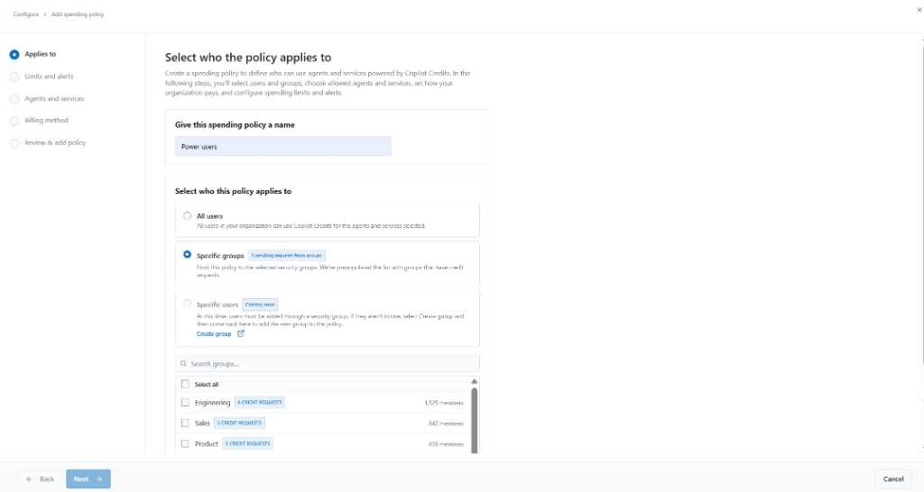
Set spending policy scope
Set policy scope for group or users
Create a spending policy to manage budget, services and alerts
Control department spend with user groups
Manage individual spending with a group of one (User level policies coming soon)
Users can belong in multiple policies, but the most targeted policy applies*
* For example, let’s say your star engineer may be capped in a larger group policy but is given more budget in a smaller, targeted policy. The bigger budget will apply since that’s a more targeted policy.
Product images subject to change
Notes:
With your default policy set, now we can move to more targeted spending policies, the controls that govern which users can use which services. Global admins, billing admins, AI admins and License admins can use these policies to manage usage at a more granular level with added flexibility.
Add groups and users to the policy. To create a policy for 1 user, create a group of one. We will add user level policies soon.
If a user belongs to multiple spending policies, we apply the most targeted policy to that user.
For example, let’s say your star engineer may be capped in a larger group policy but is given more budget in a smaller, targeted policy. The bigger budget will apply since that’s a more targeted policy.

Slide 18
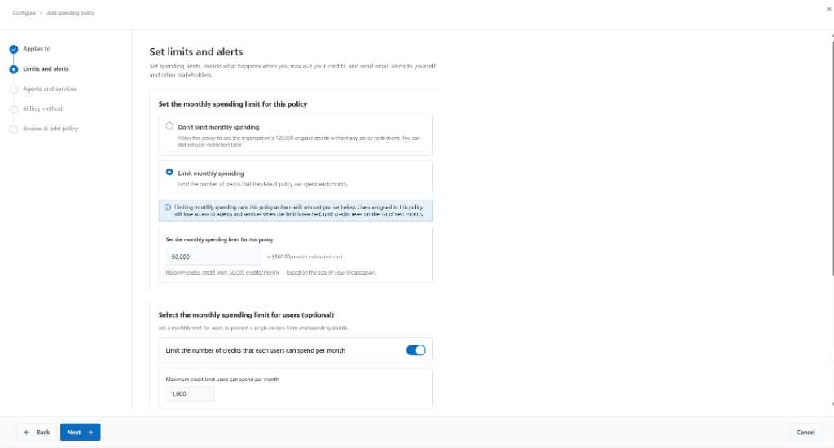
Set limits and alerts
Set limits and alerts for credit usage
Configure a limited monthly budget or not for credit usage
Set monthly hard caps
Apply optional user-level limits (ceilings) to protect shared credit capacity
Create alerts to admins and stakeholders as usage approaches defined limits
Product images subject to change
Notes:
This is where admins set the financial guardrails for Copilot Credit usage. You can configure monthly hard caps at the tenant or group level to prevent overspend, and optionally layer in per-user limits to protect shared capacity from any single heavy user. The alerts piece is just as important, you can notify admins and stakeholders as usage approaches defined thresholds, so you’re never caught off guard by an unexpected bill.

Slide 19
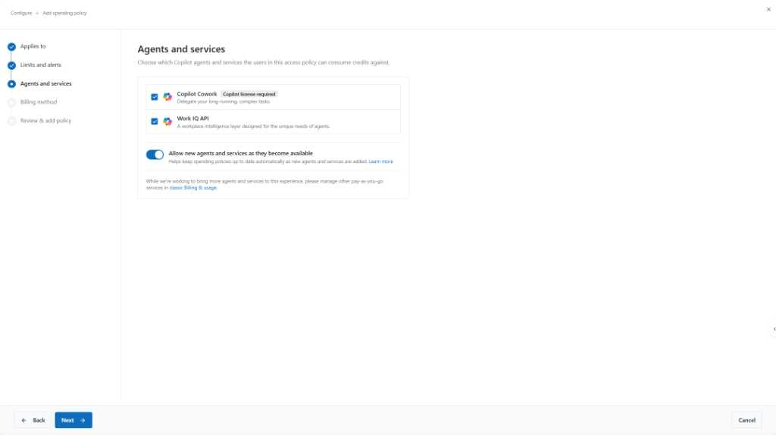
Select AI services
Select the AI services that align to this policy
Choose which AI services can be used in this policy
Limit access to services
Include newly added services when available
Product images subject to change
Notes:
This screen is where admins decide exactly which AI services are available under a given policy, so you’re not just controlling how much gets spent, but what it gets spent on. You can limit access to only the agents your organization has approved, and there’s a toggle to automatically include newly released agents and services as they become available. This gives IT a clean way to govern adoption without having to revisit every policy each time a new capability rolls out.

Slide 20
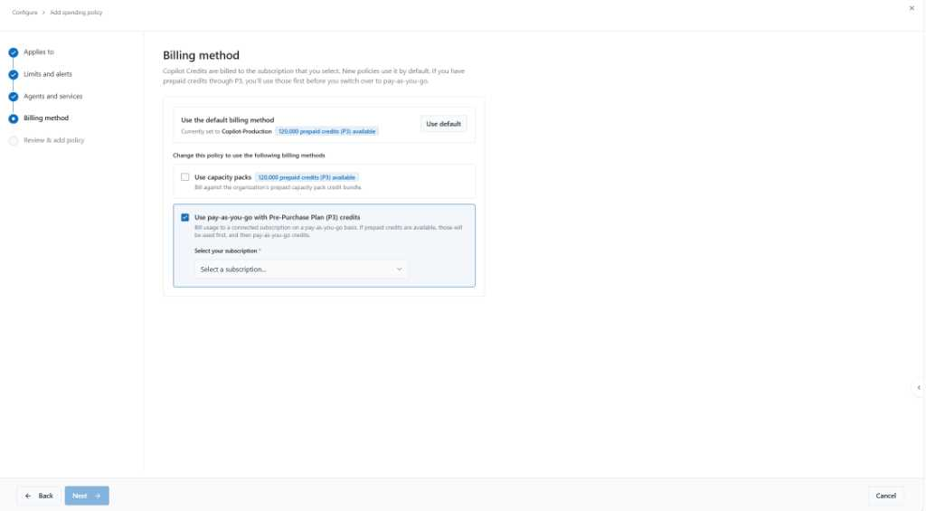
Billing method
Confirm or update billing method for this policy
Use a default billing method or select other methods for customization
Supports billing methods for different groups at the policy level
Combine prepaid credits for predictability with pay-as-you-go for flexibility
Product images subject to change
Notes:
Here admins confirm or change the billing method tied to each policy, whether that’s the tenant default or a custom method scoped to a specific group. The system automatically burns down prepaid credits before falling back to pay-as-you-go, so you always get the best per-credit rate first. This means different teams can have different billing setups without anyone having to manage the drawdown order manually.

Slide 21
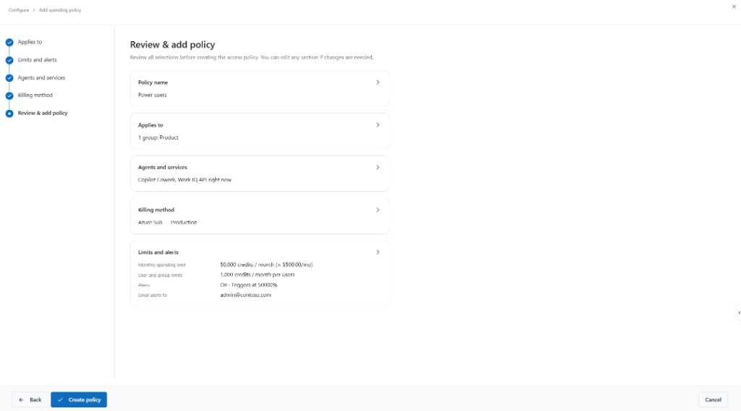
Review & create policy
Review and create your spending policy
Review your billing policy settings before creation
Enables final validation and immediately applies to scoped users
Product images subject to change
Notes:
A consolidated review step summarizes scope, services, billing, limits, and alerts in one place, letting admins validate everything before activating the policy.

Slide 22
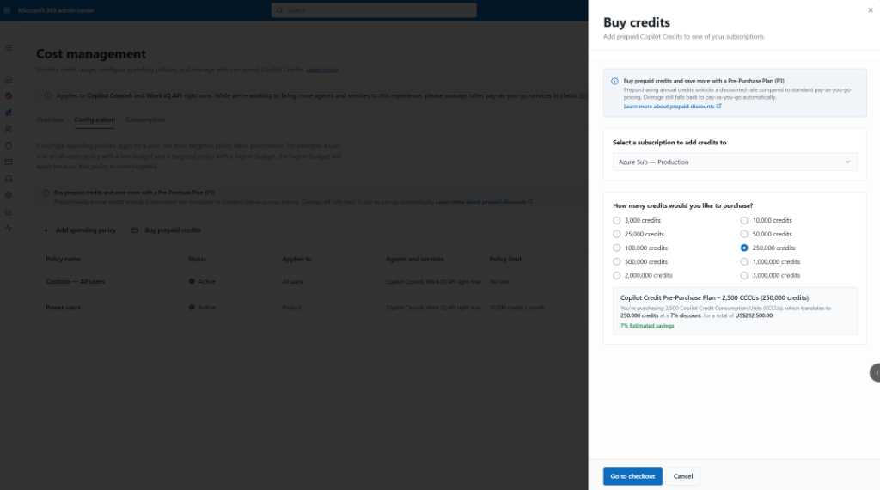
Buy prepaid credits with a Pre-Purchase Plan (P3)
Support better budget planning
Buy an annual Pre-Purchase Plan (P3) credit packs to receive a discount
Choose from a range of credit pack sizes to match expected demand
Prepaid credits are used before pay-as-you-go credits
Product images subject to change
Notes:
The Pre-Purchase Plan lets you buy annual credit packs at a volume discount, you pick the pack size that matches your expected demand and see estimated savings upfront. Those prepaid credits are always consumed first before any pay-as-you-go charges kick in, so you’re maximizing the discount. It’s a straightforward way to lock in lower costs while still keeping the flexibility to burst into pay-as-you-go if usage spikes.

Slide 23
Reporting

Slide 24
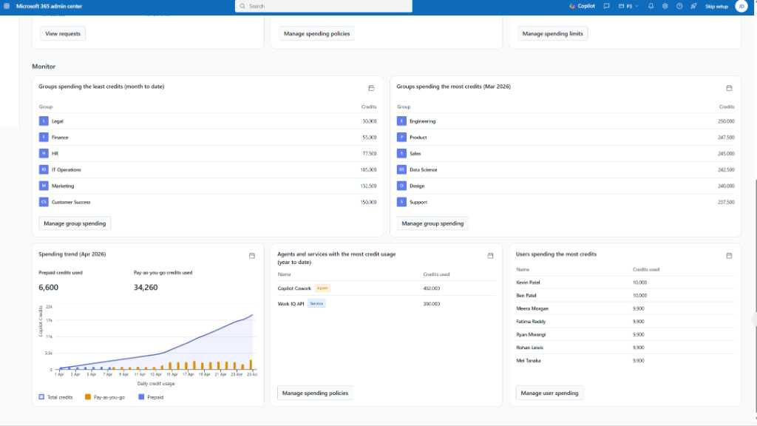
Cost Management - overview
Copilot Credit consumption
Track total credit consumption over time across prepaid and pay-as-you-go usage
View month-to-date totals, daily averages, and week-over-week trends
Surface group-level consumption patterns for prepaid and pay-as-you-go credits
Adjust and rebalance as needed
Product images subject to change
Notes:
The consumption view shows total credit usage over time across prepaid and PAYG, with month-to-date totals, trends giving admins the visibility to make informed decisions.

Slide 25
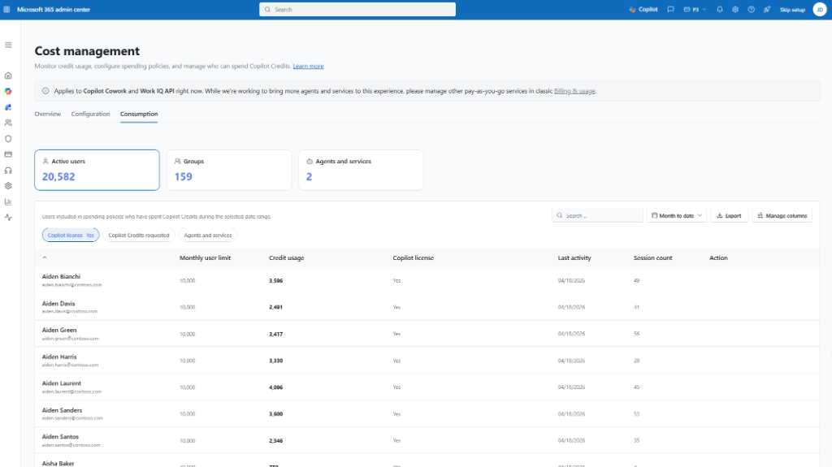
Cost Management – Consumption - Users
Copilot Credit usage
Track credit usage across active users, groups, and services from a centralized view
Monitor monthly limits, usage totals, and recent activity by individual user
Understand adoption patterns with usage intensity and session count insights
Supports more informed cost management and optimization decisions
Product images subject to change
Notes:
The Users section goes into per-user credit consumption, monthly limits, usage, intensity, last activity and session counts, so admins can spot adoption patterns and high-intensity users for targeted optimization.

Slide 26
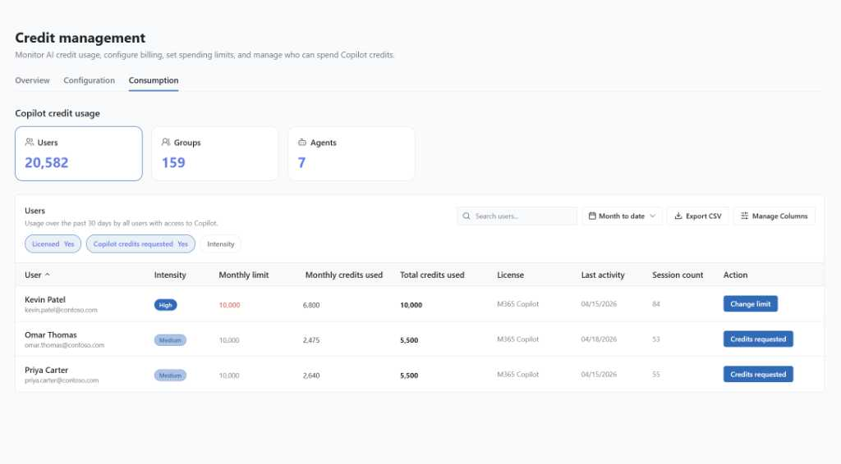
Cost Management – Consumption - Users
Copilot Credit credits requested
Filter users by requested credits, license status, and usage intensity
Surface users who have asked for additional credits alongside current usage and limits
Review recent activity, session volume, and total credits used in one view
Supports faster credit limit decisions with clearer user-level context
Product images subject to change
Notes:
Filters surface users who've requested more credits letting admins act on credit limit changes.

Slide 27
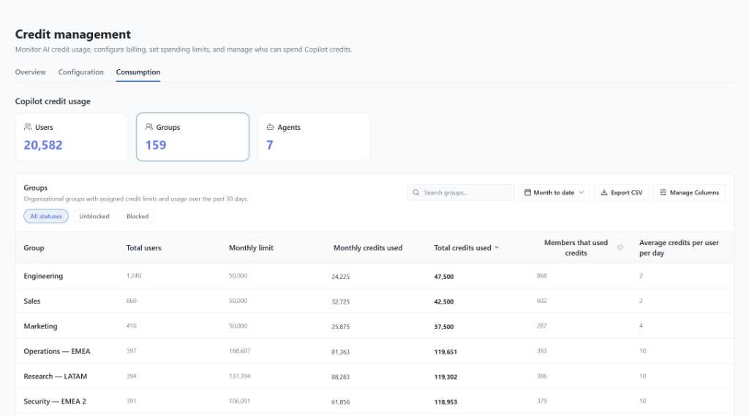
Cost Management – Consumption - Groups
Copilot Credit group usage
Monitor group credit usage, limits, and member consumption
Identify unblocked and blocked groups based on credit threshold status
Analyze total credits used, and average daily usage per user
Enables stronger oversight and group-based cost management
Product images subject to change
Notes:
The Groups view shows credit usage, limits, and member consumption by group, including blocked/unblocked status and average daily usage per user, giving admins the visibility to manage spend at the department level.

Slide 28
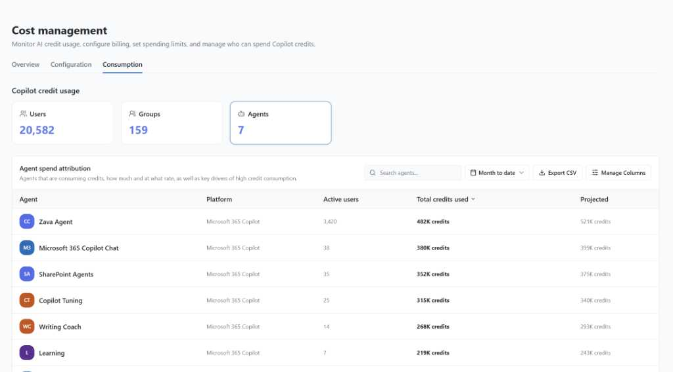
Cost Management – Agents and services
Copilot Credit agent and services spend attribution
Track which Copilot experiences are driving usage.
Identify key users of high consumption
Enable service-based cost management for granular oversight
Product images subject to change
Notes:
The Agents/Services view attributes spend to specific agents and services, showing active users, total credits used, so admins can pinpoint which agents and services are driving consumption and act accordingly.

Slide 29
Next steps
1
Learn more about Copilot Credits here
2
Activate usage-based AI services in the Cost Management dashboard

